Slide 1
PROJECT BLINDLY
Realtime object detection for blind people

Slide 2
PROJECT GUIDE : DR.P.ARJUN; HOD of CSE dept UCEV
PROJECT MEMBERS : BALAJI V, VIGNESH P
PROJECT NAME : PROJECT BLINDLY

Slide 3
PROJECT DESCRIPTION
The idea of this project is to develop an android app that notify the visually challenged people in audio form about the objects in their path. This will help them to navigate independently without others help by using real time object detection.

Slide 4
APP WORKFLOW
Open the app on a mobile phone.
On launching the app, the camera will be launched automatically.
Then the camera will capture a real time view.
The image will be processed using OpenCV.
At each instance, the detected objects will be boxed with their confidence score.
The detected object and their location will be notified to the blind people.

Slide 5
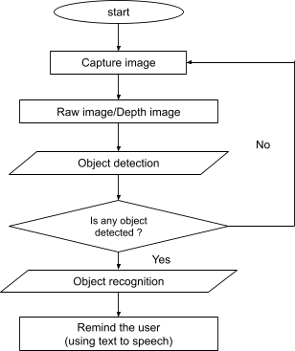
STRUCTURAL OUTLINE

Slide 6
OBJECT DETECTION ALGORITHMS
For efficient implementation, selection of algorithms is the most crucial part. Thus, different object detection algorithms like R-CNN, Fast R-CNN and YOLO are compared.
Region Based Object Detection (Accuracy)
E.g : Fast R-CNN
Regression Based Object Detection (Faster)
E.g : YOLO (you only look once), MobileNet SSD

Slide 7
REGRESSION BASED OBJECT DETECTION
Regression-based object detection algorithms divide the images into grids and provide 0 or 1 to each grid according to the object presence and absence, that is how regression-based algorithms detect objects in a single phase. As the name of regression-based algorithms also shows these algorithms work in single-phase like YOLO stands for You Only Look Once and SSD stands for Single Shot Detector.

Slide 8
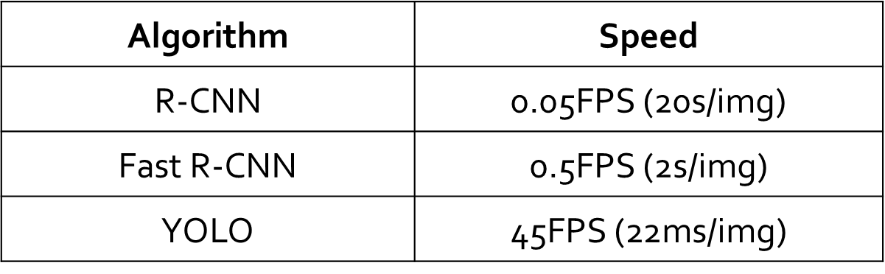
COMPARISION OF ALGORITHMS

Slide 9
YOLO ALGORITHM
YOLOV3 is faster and more accurate compared to others. YOLOv3 dataset has 80 classes and 80000 objects. In one image more than 80 different objects can be detected by YOLOv3.
High performance is required for an image to be processed. Therefore, a dataset with a minimum number of objects is needed to run YOLOv3 on any mobile phone device without compromising on the accuracy of detection.

Slide 10
PREDICTING BOUNDING BOX
Centre of a bounding box (bx ,by)
Width (bw)
Height (bh)
Class of an object ( c )
Probability of object (pc)
Y = (pc,bh,bw,bx,by,c)

Slide 11
YOLO doesn’t search for interested regions in the input image that could contain an object, instead it splits the image into cells, typically 19x19 grid. Each cell is then responsible for predicting K bounding boxes.
YOLO determines the probability that the cell contains a certain class.
The equation for the same is :
Probability that there is an object of certain class ‘c’

Slide 12
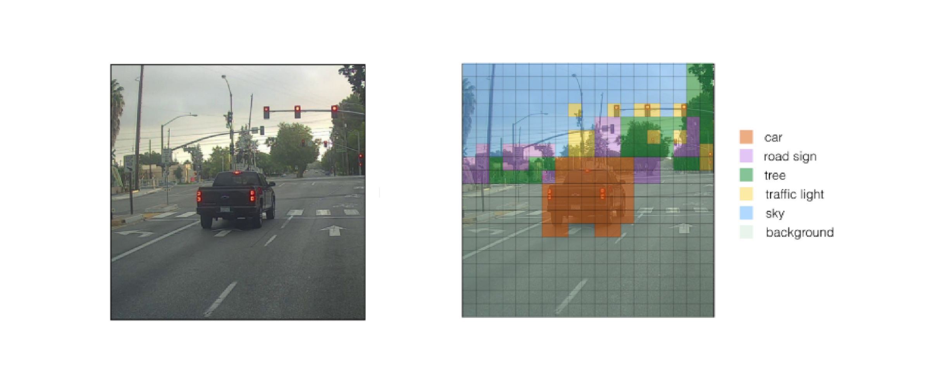
The class with the maximum probability is chosen and assigned to that particular grid cell. Similar process happens for all the grid cells present in the image.
After computing the above class probabilities, the image may look like this :

Slide 13
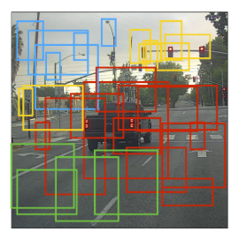
the next step is Non-max suppression, it helps the algorithm to get rid of the unnecessary anchor boxes, like you can see that in the figure below, there are numerous anchor boxes calculated based on the class probabilities.
Anchor boxes

Slide 14
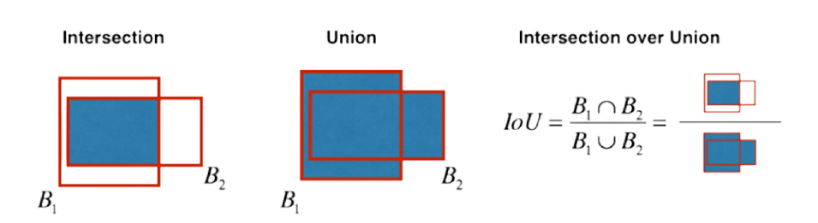
To resolve this problem Non-max suppression eliminates the bounding boxes that are very close by preforming the IoU (Intersection over Union) with the one having the highest class probability among them.

Slide 15
It calculates the value of IoU for all the bounding boxes respective to the one having the highest class probability, it then rejects the bounding boxes whose value of IoU is greater than a threshold. It signifies that those two bounding boxes are covering the same object but the other one has a low probabilty for the same, thus it is eliminated.
Once done, algorithm finds the bunding box with next highest class probabilities and does the same process, it is done until we are left with all the different bounding boxes.

Slide 16
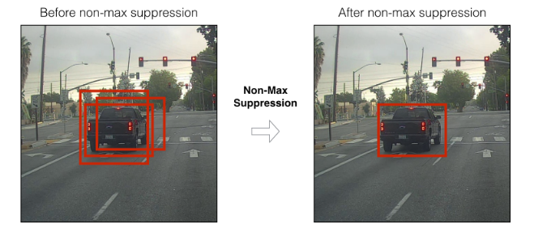
After this, almost all of our work is done, the algorithm finally outputs the required vector showing the details of the bounding box of the respective class.

Slide 17
COLLECTING DATA SET

Slide 18
DETECTION OF OBJECTS
For the detection of objects, YOLOv3 uses multi-label classification. Instead of using the softmax function, it uses independent logistic classifiers and threshold values.

Slide 19
FEATURE EXTRACTION
For feature extraction, YOLOv3 uses Darknet-53 (a network trained on the ImageNet), and Residual networks(ResNet). The network uses 53 convolution layers (hence the name Darknet-53) where the network is built with consecutive 3x3 and 1x1 convolution layers followed by a skip connection.

Slide 20
COMPARISION OF YOLO VERSIONS
Model | Model Size | Dataset | FPS | mAP | BFLOPs
YOLOv2 | 202.3M | DOTA | 58.3 | 17.6 | 44.417
YOLOv3 | 245.78M | DOTA | 14.7 | 55.8 | 101.784
YOLOv4 | 246.3M | MS COCO | 18.5 | 55.4 | 128.459

Slide 21
DRAWBACKS
The object should not be far away from the camera.
The object should not be small.
The dataset should not be large to improve speed.
The detection of sun will be difficult.

